Slide 1


SpotMicro AI Dog in Egypt

Slide 2



01
Project Overview

Slide 3
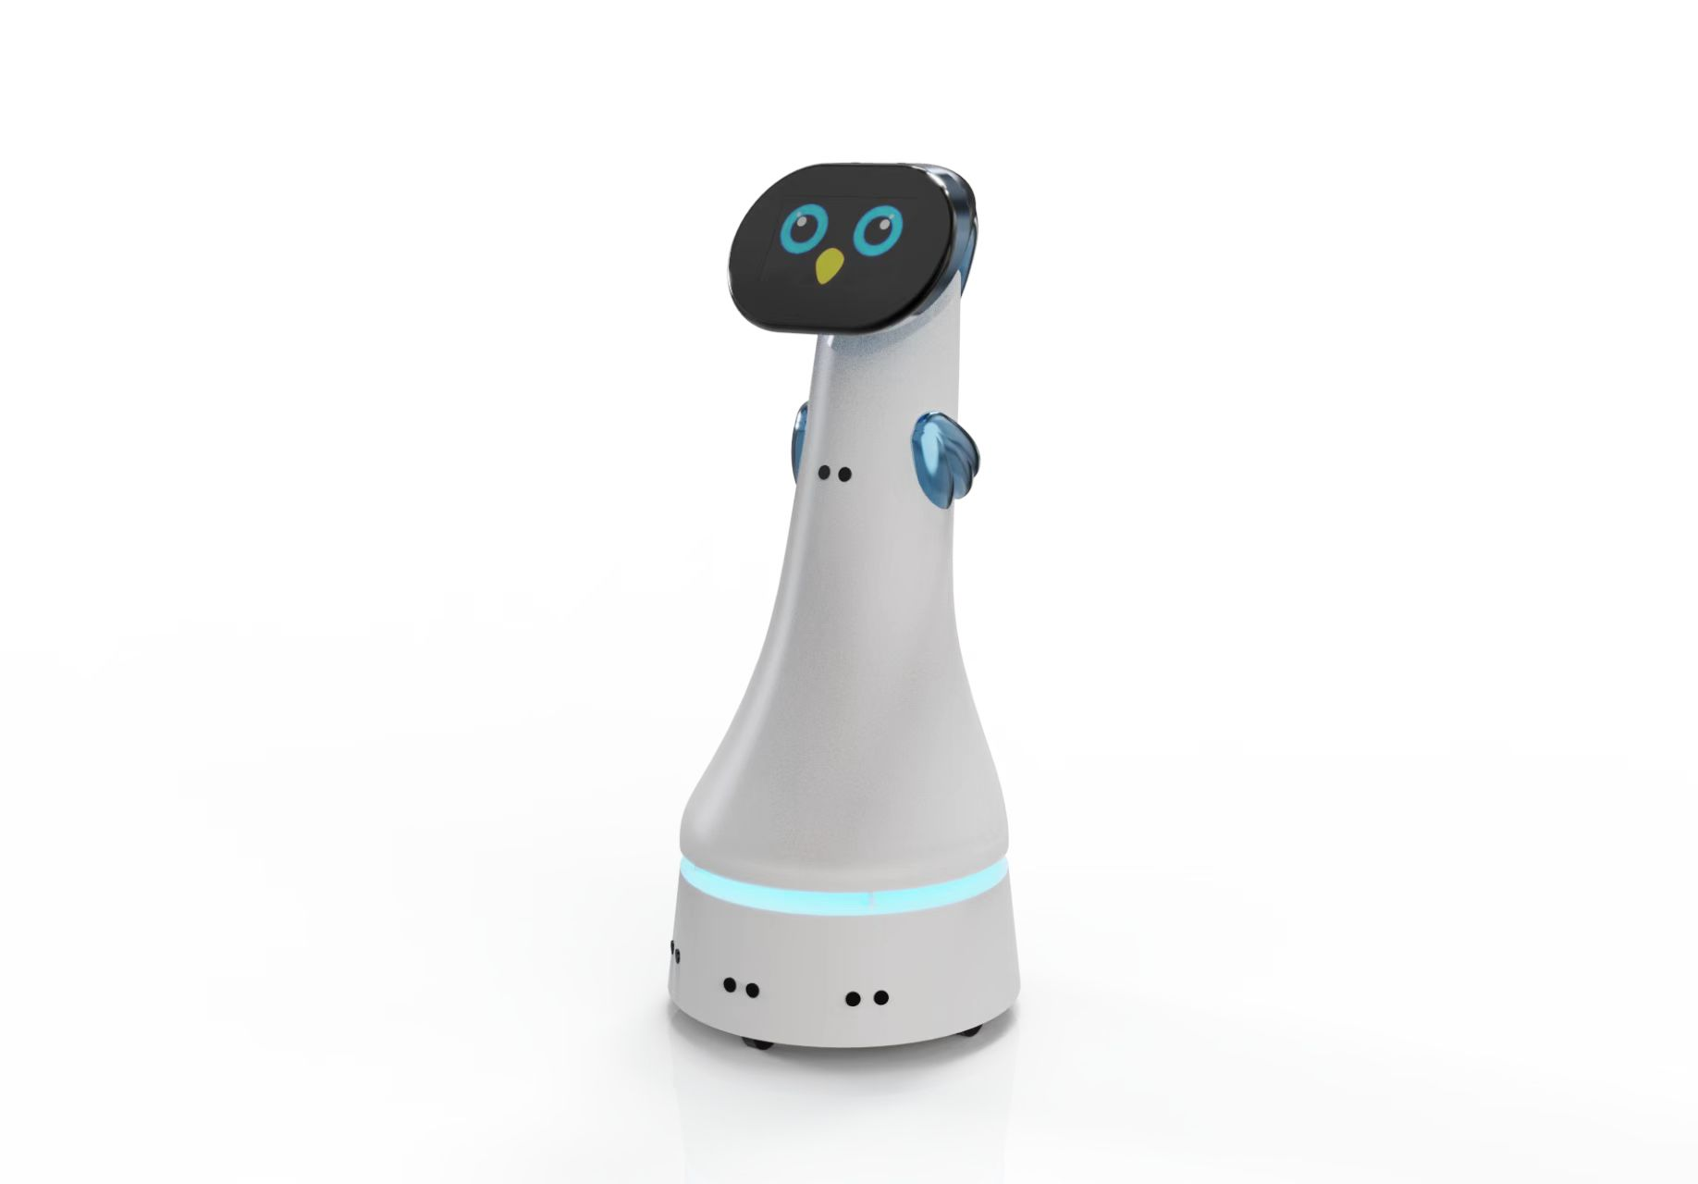
SpotMicro AI Dog
Autonomous Quadruped Robot Project in Egypt
Building a smart, affordable, and locally-sourced quadruped robot featuring dynamic walking, stereo vision, NLP, and person-following capabilities. Leveraging open-source models and Egyptian components for a cost-effective innovation showcase.

Slide 4
Executive Summary
AI-Driven Autonomy
6,670 EGP Budget
20-Hour Timeline
SLAM, Voice Interaction, LLM Integration
Cost-effective using locally sourced components
Rapid development and deployment cycle

Slide 5
02
Mechanical Design

Slide 6

Mechanical Platform
SpotMicro V4 Structure
The robot's chassis is based on the open-source SpotMicro V4 model, with all parts fabricated locally using PLA and flexible filaments . This ensures a lightweight, durable, and modular structure.
3D Printer: Creality Ender 3
Infill: 10-20%
Colors: White, Black, Gray

Slide 7
Actuation & Mobility
Powered by twelve high-torque MG996R servos for dynamic locomotion.
11
180°
0.15s
kg·cm Stall Torque
Range of Motion
Speed per 60°
Three servos per leg provide comprehensive control for stable walking, turning, and balancing on varied terrain.

Slide 8
03
Electronics Core

Slide 9
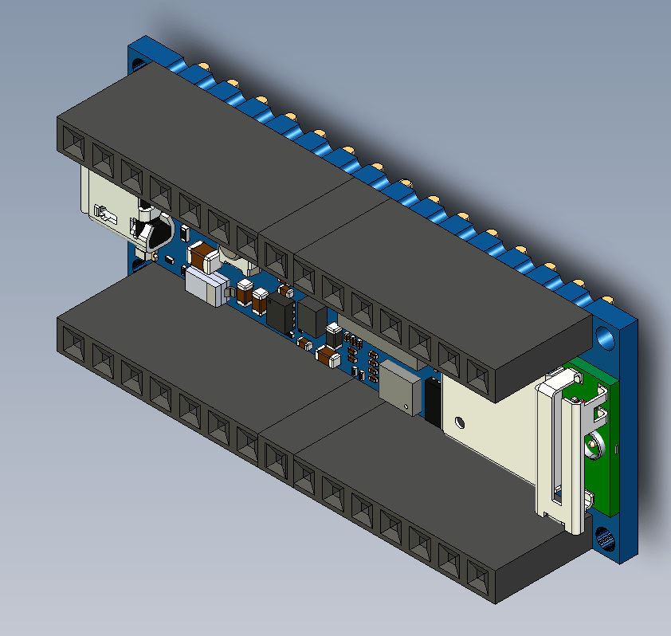
The Brain: Arduino RP2040
The Arduino Nano RP2040 Connect serves as the central controller, managing real-time operations, sensor fusion, and connectivity.
Wi-Fi & Bluetooth
Onboard IMU (LSM6DSOXTR)
Built-in Microphone

Slide 10
Synchronized Servo Control
Precise movement is achieved using a dedicated PWM driver.
Arduino Nano
PCA9685 Driver
12x MG996R Servos
Main Controller
I²C PWM Control
Coordinated Motion
The PCA9685 provides 16 channels of 12-bit PWM control, enabling precise and synchronized servo movements without overloading the main processor.

Slide 11
04
Sensor Suite

Slide 12
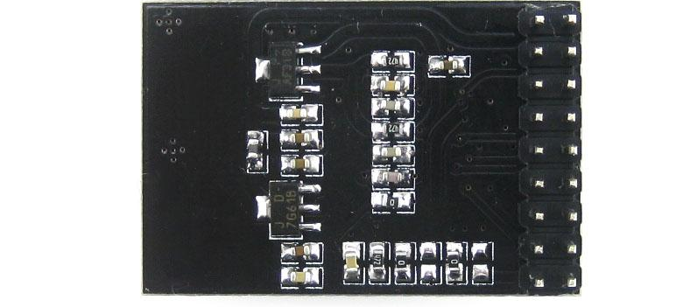
Depth & Vision Sensors
Enabling intelligent perception with stereo vision.
A pair of OV9655 camera modules provide the foundation for the robot's vision, enabling depth perception and Simultaneous Localization and Mapping (SLAM).
Obstacle detection and avoidance
Environment mapping and navigation
Visual feedback for PC-based AI

Slide 13
Motion & Sound Detection
A suite of sensors for reactive and interactive behaviors.
PIR Motion
Ultrasonic Distance
Acoustic Localization
HC-SR501 for person/object following.
HC-SR04 for precise obstacle ranging.
MAX4466 mics for sound source tracking via TDOA.

Slide 14
Global Positioning
Voice Interaction
The NEO-6M GPS module provides essential outdoor localization, enabling autonomous navigation over larger areas and geo-fenced operations.
A PAM8403 audio amplifier and speaker allow the robot to provide audible feedback and responses, creating a more natural human-robot interaction.

Slide 15
05
AI & Autonomy

Slide 16
Onboard AI: Real-Time Tasks
Lightweight intelligence running on the RP2040 microcontroller.
Wake Word Detection
Hand Gesture Recognition
Balance & Control
Using OpenWakeWord for always-listening activation.
Using MediaPipe for basic commands.
Real-time IMU processing under FreeRTOS.

Slide 17
PC-Based AI: Heavy Lifting
High-performance AI processing for advanced autonomy.
Speech Recognition (Vosk ASR)
Computer Vision (OpenCV)
For complex command parsing.
For object detection & SLAM.
Conversational AI (LLM)
Path Planning (A*/D* Lite)
Using Llama 3.2 for dialogue.
For intelligent navigation.

Slide 18
Path Planning & SLAM
Fusing data for intelligent navigation and mapping.
Stereo Vision
GPS / IMU
ES-EKF Fusion
2D Map & Path
An Extended-State Extended Kalman Filter (ES-EKF) fuses data from multiple sources to create a robust understanding of the robot's state and environment, enabling it to build maps, avoid obstacles, and follow users effectively.

Slide 19
06
Software Stack

Slide 20
Firmware & RTOS Architecture
Reliable, real-time performance with FreeRTOS.
Real-Time Tasks (FreeRTOS)
Communication & Control
Sensor Data Collection
MQTT Messaging
Servo Control Loops
I²C for Servo Driver
Wake Word Detection
Interrupts for PIR
IMU Balance Control
RTOS Task Scheduling

Slide 21
ROS 2 & MQTT Bridge
Seamless integration between robot and PC.
Robot (MQTT Client)
MQTT Broker
PC (ROS 2 Nodes)
The robot publishes sensor data to an MQTT broker. A PC running ROS 2 subscribes to these topics, processes the data using advanced AI algorithms, and publishes commands back to the robot, creating a robust, modular, and scalable system.

Slide 22
Simulation & Training
Accelerating development in a virtual world.
Physics Simulation
Reinforcement Learning
Using Gazebo & PyBullet to test gait and obstacle avoidance algorithms safely.
Using Isaac Gym to optimize locomotion patterns on a local GPU workstation.
Simulation allows for rapid prototyping, reduces the risk of hardware damage, and accelerates the development cycle by enabling testing in a wide variety of virtual environments before real-world deployment.

Slide 23
07
Timeline & Budget

Slide 24
20-Hour Development Roadmap
A fast-paced, milestone-driven project timeline.
Phase 1
3D Printing & Assembly
Phase 2
Electronics Integration
Phase 3
Firmware & Basic Gait
Phase 4
Perception & SLAM
Phase 5
AI & Autonomy Features
Phase 6
System Testing & Optimization

Slide 25
Component Cost Breakdown
A detailed look at the 6,670 EGP budget.
Arduino Nano RP2040 Connect: 1,750 EGP
MG996R Servos (x12): 2,520 EGP
PCA9685 PWM Driver: 210 EGP
Stereo Cameras (x2): 700 EGP
GPS Module: 450 EGP
Sensors & Audio: ~780 EGP
Battery & Misc: ~1,260 EGP
Grand Total: 6,670 EGP

Slide 26
Local Supplier Ecosystem
Reliable, fast procurement from trusted Egyptian suppliers.
MakerSelectronics
RAM Electronics
Servos, Drivers, Sensors
Arduino, Cameras
FUT Electronics
Micro Ohm
Audio Components
Miscellaneous Parts

Slide 27
08
Use Cases & Impact

Slide 28

Use Case: Education & Research
A low-cost, open-source platform perfect for Egyptian universities and tech schools. It provides a hands-on tool for teaching robotics, AI, and embedded systems, fostering a new generation of engineers.
Robotics & AI Curriculum
Student Research Projects
Engineering Competitions

Slide 29
Use Case: Smart Assistance
An intelligent companion for everyday life.
Home Helper
Elderly Companion
Security Patrol
Voice-controlled tasks and monitoring.
Friendly interaction and safety alerts.
Autonomous patrols with person following.

Slide 30
09
Next Steps

Slide 31
Next Steps: Prototype Assembly
From plan to reality: the immediate action plan.
1. Component Procurement
2. Mechanical Assembly
Order all electronics from local suppliers and contract a 3D print shop for the mechanical parts.
Assemble the 3D-printed chassis, mount the servo motors, and install the electronic boards.
3. Electronics Integration
4. Firmware Upload
Wire all sensors, servos, and modules. Perform initial power-on tests and connectivity checks.
Upload the FreeRTOS-based firmware and test basic servo movements and sensor readings.

Slide 32
Next Steps: Testing & Iteration
A structured approach to refinement and optimization.
Balance
Tune Gait & Stability
SLAM
Validate Mapping
Test Commands & Vision
AI
System
User Trials & Feedback

Slide 33




Slide 34


